Slide 1
POPULAR VIDEO CONTENT RECOMMENDATION TOOL FOR OVER-THE-TOP STREAMING SERVICES
Purpose
Demo
Insights
Data
Recommendation Tool
MSBD5005 Data Visualization
Group 16: Chan Kar Chun (20729353), Lakhani Harsh Sunil (20910249),
Tsang Kai Ho (20905476), Wong Yan Ho (20605624)

Slide 2
TABLE OF CONTENTS
02
03
DATA
PURPOSE
04
05
06
DEMO
INSIGHTS
RECOMMENDATION
TOOL
01
02
Our datasets descriptions
Our purpose and goal
03
04
05
Demonstration of our vis system
Analysis of visualizations
User interactions

Slide 3

01
DATA
Purpose
Demo
Insights
Data
Recommendation Tool
01

Slide 4
DATA — Overview
Purpose
Demo
Insights
Data
Recommendation Tool
Streaming Platform | Number of Features | Number of Videos | TV Show Percentage | Movie Percentage
Amazon Prime Video | 18 | 9871 | 14% | 86%
Disney+ | 18 | 1535 | 27% | 73%
HBO Max | 18 | 3294 | 23% | 77%
Netflix | 18 | 5850 | 36% | 64%

Slide 5
DATA — Overview
Purpose
Demo
Insights
Data
Recommendation Tool
Attributes | Description | Attributes | Description
id | The video ID provided on JustWatch | seasons | The number of seasons of a show
title | The name of a video | name | The name of the actor/actress of a video
type | TV show or movie | character | The character name of the actor/actress in the video
description | A brief description of a video | role | Actor/actress or director
release_year | The year of release of a video | imdb_id | The video ID on IMDb
age_certfication | Age certification for a video | imdb_score | The score of a video on IMDb
runtime | The length of a movie or an episode of a TV show | imdb_votes | The votes of a video on IMDb
genres | The genres of a video | tmdb_score | The score of a video on TMDb
production_countries | The countries produced a video | tmdb_popularity | The popularity of a video on TMDb

Slide 6
DATA — Source
Purpose
Demo
Insights
Data
Recommendation Tool
Streaming Platform | Source URL
Amazon Prime Video | https://www.kaggle.com/datasets/victorsoeiro/hbo-max-tv-shows-and-movies
Disney+ | https://www.kaggle.com/datasets/victorsoeiro/amazon-prime-tv-shows-and-movies?select=titles.csv
HBO Max | https://www.kaggle.com/datasets/victorsoeiro/amazon-prime-tv-shows-and-movies?select=titles.csv
Netflix | https://www.kaggle.com/datasets/victorsoeiro/amazon-prime-tv-shows-and-movies?select=titles.csv

Slide 7
PURPOSE
Purpose
Demo
Insights
Data
Recommendation Tool
02

Slide 8
PURPOSE
BACKGROUND
GOAL
TASKS
Purpose
Demo
Insights
Data
Recommendation Tool
Survey findings indicate that although Amazon offers more content, Netflix reigns as the more popular streaming service. This could be because of the quality of content.
Our aim is to help Content Producers create popular content by analyzing various attributes of movies and TV shows and providing valuable insights.
Explore the optimal combination of attributes that drive popularity in video content.

Slide 9
DEMO
Purpose
Demo
Insights
Data
Recommendation Tool
03

Slide 10
Purpose
Demo
Insights
Data
Recommendation Tool

Slide 11
INSIGHTS
Purpose
Demo
Insights
Data
Recommendation Tool
04

Slide 12
Purpose
Demo
Insights
Data
Recommendation Tool

Slide 13
Purpose
Demo
Insights
Data
Recommendation Tool

Slide 14
RECOMMENDATION TOOL
Purpose
Demo
Insights
Data
Recommendation Tool
05

Slide 15
Purpose
Demo
Insights
Data
Recommendation Tool

Slide 16
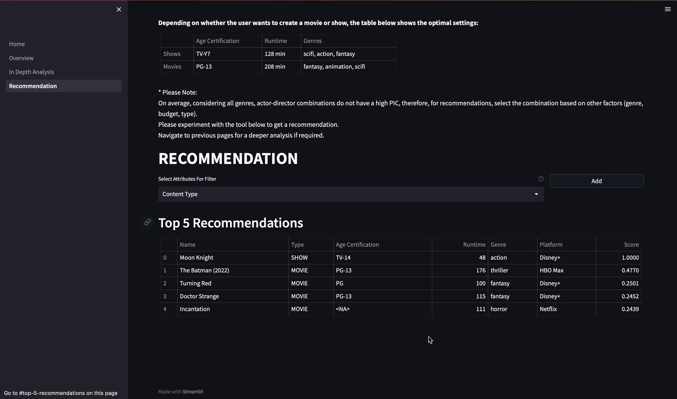
Purpose
Demo
Insights
Data
Recommendation Tool

Slide 17
THANK YOU!
Purpose
Demo
Insights
Data
Recommendation Tool
Please feel free to raise your questions.

